Slide 1


Slide 2

CHAPTER 4: Knowledge and Reasoning
College of Computing and Informatics
Department of Software Engineering
Fundamentals of Artificial Intelligence
Compiled by Aliazar D.
BSc & MSc in Software Engineering
aliazar.deneke@wku.edu.et

Slide 3

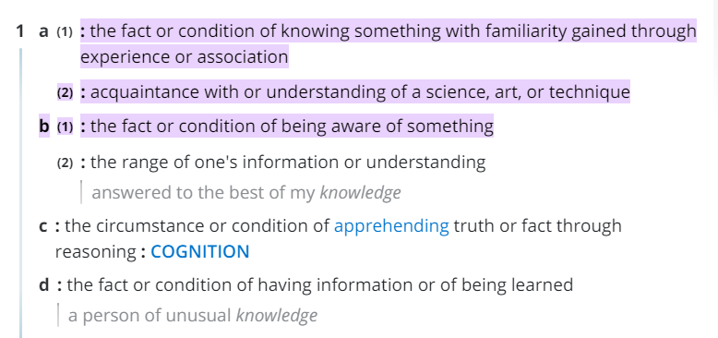
What is knowledge?
What is knowledge in context of AI?
In the context of artificial intelligence (AI),
Knowledge refers to the information and data that is used to train and develop AI systems.
This knowledge can come from a variety of sources, including human experts, existing databases, and other AI systems.
The goal of AI is to use this knowledge to create intelligent systems that can learn, reason, and make decisions on their own.
In order to do this, AI systems must be able to process and analyze large amounts of data, identify patterns and relationships, and use this information to make predictions and recommendations.

Slide 4

Knowledge
Knowledge includes facts about the real world entities and the relationship between them.
Characteristics of Knowledge:
It is voluminous in nature and requires proper structuring.
It may be incomplete and imprecise.
It may keep on changing (dynamic).
There is a need to represent knowledge to ease the development of an intelligent system.
Different knowledge representation schemes may be appropriate depending on tasks and circumstances.
How to represent knowledge in AI?

Slide 5
Motivation
Knowledge Based Systems (KBSs) are useless without the ability to represent knowledge.
Intelligent system require:
Knowledge: (current state) of the world.
Formally represented using knowledge representation language.
Inference mechanisms: to deduce new facts/knowledge that are unseen by current percepts.
Goal: what it wants to achieve?
Effect of its action: what its own action do in various circumstances?

Slide 6
Knowledge Based Agent (KBA)
Agents can be seen as knowing about their world, and reasoning about their possible courses of action.
One can also design an autonomous agent that.
Learns and construct knowledge without human interventions.

Slide 7
Components of a KBA
The agent is composed of:
Knowledge base:
It operates by storing a set of sentences (facts and relationship between facts) about the world in its KB.
Inference mechanism :
With the help of inference mechanism deduce new sentences and use them to decide what action to take.
Learning mechanism:
Adapt to changes in the environment by updating the relevant knowledge.
Input from
environment
Inference
Engine
Output
(actions)
Learning
(KB update)
Knowledge
Base

Slide 8
Knowledge Base (KB)
Contains set of facts about the domain expressed in a suitable representation language.
Each individual representation are called sentences.
Sentences are expressed in a (formal) knowledge representation (KR) language.
A KBA is designed such that there is a way to:-
TELL it (i.e. to add new sentences to the KB).
ASK it (i.e. to query the KBA).
PERFORM it (i.e. to take action based on KB).
When one ASKs a question, the answer should follow from what has been TELLed to the KB previously.
Inference mechanism determines what follows from what has been TELLed to the KB.
Input from
environment
Inference
Engine
Output
(actions)
Learning
(KB update)
Knowledge
Base

Slide 9
Inference Engine
The Inference engine derives new sentences from the input and KB.
The inference mechanism depends on representation in KB.
The agent operates as follows:
1. It receives percepts from environment.
2. It computes what action it should perform (by IE and KB).
3. It performs the chosen action (some actions are simply inserting inferred new facts into KB).
Input from
environment
Inference
Engine
Output
(actions)
Learning
(KB update)
Knowledge
Base

Slide 10
KB can be viewed at different levels
Knowledge Level
The most abstract level -- describe agent by saying what it knows.
Example: An automated taxi might be said to know that the Wabe Bridge links Wolkite and Gubre.
Logical Level
The level at which the knowledge is encoded into sentences.
For e.g. The taxi might be described as having the logical sentences.
Links(Wabe,Wol,Gub) in the knowledge base.
Implementation Level
The physical representation of the sentences in the logical level - how will it be represented in the computer?

Slide 11
Logical reasoning
A logical, knowledge-based agent begins with some knowledge of the world and of its own actions.
It uses logical reasoning to maintain a description of the world as new percepts arrive, and to deduce a course of action that will achieve its goals.

Slide 12

Knowledge Representation, Reasoning and Logic

Slide 13
Knowledge Representation & Reasoning
Knowledge Representation (KR): express knowledge explicitly in a computer-tractable way such that the agent can reason out.
Parts of KR language:
Syntax of a language: describes the possible configuration to form sentences. E.g.: if x & y denote numbers, then x > y is a sentence about numbers.
Semantics: determines the facts in the world to which the sentences refer. E.g.: x > y is false when y is greater than x and true otherwise.
Proof theory (inference rules and proof procedures).
Reasoning: is the process of constructing new sentences from existing facts in the KB.
Proper reasoning ensures that the new configuration represent facts that actually follow from the facts in the KB.

Slide 14
Why KR is important ?
It enables to:
Automated Reasoning,
Discover new facts,
Deduce new facts that follows the KB,
Answer users queries,
Make decisions - select courses of actions,
And, etc.

Slide 15

How is Knowledge represented?
Construct KB by TELLing the agent what it needs to know.
Add sentences one by one that represent the domain knowledge using KR language.
Knowledge is basically represented as “symbol structures” (essentially, complex data structures) representing bits of knowledge (objects, concepts, facts, rules, strategies and etc.).
Example: “red” represents color red.
“mycar” represents my car.
red(mycar) represents the fact that my car is red.
Intelligent behavior can be achieved through manipulation of symbol structures.

Slide 16
Procedural vs. Declarative Languages
Procedural languages are programming languages that follow a step-by-step approach to solving a problem.
In procedural programming, the programmer writes a series of instructions that the computer follows in order to complete a task.
Examples of procedural languages: include C, Java, Pascal, and Fortran.
Declarative languages, on the other hand, focus on what the program should accomplish rather than how it should accomplish it.
In declarative programming, the programmer specifies the desired outcome or goal, and the computer figures out how to achieve it.
Examples of declarative languages: include SQL, Prolog, and Haskell.
Define, compare and contrast.
The main difference between procedural and declarative languages is that procedural languages are more focused on the process of solving a problem, while declarative languages are more focused on the outcome or result. Procedural languages tend to be more flexible and allow for more control over the program's execution, while declarative languages tend to be more concise and easier to read and understand.
Therefore, Knowledge Base must be constructed following declarative approach.
Rather than procedural language (like C++/Java data structures), use declarative languages (like prolog), & also python even if it is not a purely declarative language, but it does support it.

Slide 17
Requirement for KR languages
Representational adequacy: the KR language should be effective in representing the knowledge you need for your problem.
Is the KR language allows to represent simple or complex knowledge?
Understandability: the representational scheme should enable to do it in a clear, precise and “natural” way.
Choose names for symbols that are meaningful.
Inferential adequacy: have appropriate inference methods to reason on knowledge represented and draw new conclusions.
A balance must be found between effective representation, understandability and Inferential adequacy.

Slide 18
Logic as KR
A Logic is a formal language in which knowledge can be represented such that conclusions can be drawn.
It is a declarative language to assert sentences and deduce from sentences.
Components of a formal logic include: syntax, semantics, reasoning and inference mechanism.
Syntax: what expressions/structures are allowed in the language. Describes how to make sentences.
E.g. red(mycar) is ok, but mycar(grey or green) is not.
Semantics: express what sentences mean, in terms of a mapping to real world.
The meaning of a sentence is not intrinsic (belonging naturally) to that sentence. Semantics relate sentences to reality.
E.g. red(mycar) means that my car is red.
Proof Theory: how we can draw new conclusions from existing statements in the logic.
It is a means of carrying our reasoning using a set of rules.

Slide 19
Why formal languages (Logic)?
An obvious way of expressing or representing facts and thoughts is by writing them in a natural language such as English, Amharic, etc.
However,
The meaning of a sentence depends on the sentence itself and on the context on which the sentence was spoken.
e.g. Look!
Natural languages exhibit ambiguity. E.g. small dogs and cats.
A single sentence can usually be interpreted in more than one way, possibly inhibiting reasoning. Consider English sentences like:
“The boy saw a girl with a telescope”
“Our shoes are guaranteed to give you a fit”

Slide 20
The word "look" can have different meanings depending on the context in which it is used.
Here are some examples:
1. To direct one's gaze: "She looked out the window and saw the sun setting."
2. To appear or seem: "It looks like it's going to rain today."
3. To investigate or examine: "The police are looking into the matter."
4. To search for something: "I'm looking for my keys. Have you seen them?"
5. To have a particular appearance or style: "That dress looks great on you."
6. To pay attention or be aware: "Look, I need you to listen to me for a moment."
7. To express an opinion or viewpoint: "From where I'm standing, it looks like a bad idea."
8. To expect or anticipate: "I'm looking forward to seeing you again."
9. To take care of or watch over: "Can you look after the kids while I'm out?"
10. To give the impression of being: "He looks like a professional athlete."
Natural languages like English often exhibit ambiguity, which can lead to confusion or misinterpretation. The phrase "small dogs and cats" is a good example of this.
Depending on the context, "small dogs and cats" could mean:
1. Dogs and cats that are both small in size: "The animal shelter has a section for small dogs and cats."
2. Dogs that are small and cats of any size: "I saw small dogs and cats in the park today."
3. Dogs of any size and cats that are small: "The vet specializes in treating small dogs and cats."
In each of these cases, the phrase "small dogs and cats" could be interpreted in different ways, depending on the context and the speaker's intention. This is why it's important to consider the context and use other clues, such as tone of voice or body language, to help understand the meaning of ambiguous phrases.
A single sentence can often be interpreted in more than one way, which can lead to ambiguity and inhibit reasoning.
The two examples below are good illustrations of this:
1. "The boy saw a girl with a telescope" could be interpreted in two different ways:
- The boy saw a girl who was using a telescope to look at something.
- The boy saw a girl and he was using a telescope to see her from a distance.
Depending on the context, either interpretation could be valid, and this ambiguity could lead to confusion or miscommunication.
2. "Our shoes are guaranteed to give you a fit" is another example of a sentence that can be interpreted in more than one way:
- Our shoes are guaranteed to fit you well and be comfortable.
- Our shoes are guaranteed to cause you discomfort or pain.
Again, depending on the context and the speaker's intention, either interpretation could be valid, and this ambiguity could lead to confusion or misunderstanding.
To avoid ambiguity and promote clear communication, it's important to consider the context and use additional information or cues to help clarify the intended meaning of a sentence.

Slide 21
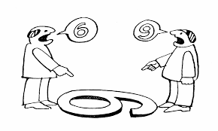

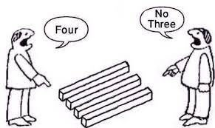
Ambiguity makes reasoning difficult and incomplete.
Hence we need formal languages to express facts and concepts in an unambiguous and well-defined way.

Slide 22
Knowledge Representation Languages
What makes it different from Programming Languages and Natural Language?
Programming languages are designed to completely describe the state of the computer and how it changes as the program executes. (they are not expressive since they can not infer).
They do not offer easy ways to say what we want to say.
E.g. How will you express the sentence
“The financial statement is wrong”,
You have a headache.

Slide 23
Natural languages
Natural languages are certainly expressive,
They help us for communication, not for representation.
A good way for a speaker to get a listener to come to know something.
Natural language also suffers from ambiguity.
Small dogs and cats.
Dangerous men and locations.

Slide 24
Logics
Logic is the science or art of reasoning.
Concerned with what is true and how we know whether something is true.
Two kinds of Logic
Propositional or Boolean Logic
First-order Logic
In both propositional and first order logic, a sentence represents a fact and the agent either believes the sentence to be true, believes it to be false, or is unable to conclude either way.
These logics therefore have three possible states of belief.
Systems using probability theory, on the other hand, can have any degree of belief, ranging from 0(total disbelief) to 1 (total belief).

Slide 25
Propositional Logic
It is a very simple logic.
Symbols represent facts.
Symbols of propositional logic are the logical TRUE and FALSE.
E.g. P ≡ AAU is one of the accredited universities in Africa (may or may not be true).
Propositional symbols can be combined using Boolean connectives to generate sentences with more complex meaning.

Slide 26
First Order Logic
Commits the representation of the world in terms of objects and predicates on objects.
Predicates may be properties, relationships.
Uses connectives and quantifiers.
Later, we will see
FOL is able to capture a good deal of what we know about the world.
FOL is used to represent and deduct facts.

Slide 27

Propositional Logic

Slide 28
Propositional Logic (PL)
A simple language useful for showing key ideas and definitions.
Syntax: PL allows facts about the world to be represented as sentences formed from:
Logical constants: True, False,
Proposition symbols (P, Q, R, …) are used to represent facts about the world: e.g.: P = "It is hot“, Q = "It is humid“, R = "It is raining“,
Logical connectives: not (¬), and (∧), or (∨), implies (→), (≡) is equivalent, if and only if (↔).
Parenthesis ( ): Used for grouping sentences and to specify order of precedence.
(P → (Q →(¬(R))) vs. P → (Q → ¬R),
Precedence order from highest to lowest is: ¬, ∧,∨,→, ↔,
The sentence ¬P v Q ∧ R → S is equivalent to ((¬P) v (Q ∧ R)) → S,
Binary operators are left associative: so P → Q → R is (P → Q) → R,
Questions: (Activity!)
Is (P ∨ Q) ∨ R same as P ∨ (Q ∨ R) ?
Is (P ∧ Q) ∧ R same as P ∧ (Q ∧ R) ?
Is (P → Q) → R same as P → (Q → R) ?

Slide 29
Conti..
1. (P ∨ Q) ∨ R is the same as P ∨ (Q ∨ R) because both expressions evaluate to true if at least one of the variables P, Q, or R is true. The order in which the OR operators are applied does not affect the final result.
2. (P ∧ Q) ∧ R is the same as P ∧ (Q ∧ R) because both expressions evaluate to true only if all three variables P, Q, and R are true. The order in which the AND operators are applied does not affect the final result.
3. (P → Q) → R is not the same as P → (Q → R) The first expression evaluates to true if either P is false or R is true, or if both P is true and Q is true and R is true. The second expression evaluates to true if either P is false or Q or R is true, or if both P is true and Q is true and R is true. These two expressions are not equivalent because the order in which the implication operators are applied does affect the final result.
i.e. P → Q is True when
Both P & Q are True or False, and also If P is False and Q is True
If P is True and Q is False then P → Q is False
More..

Slide 30
Conti..
A sentence is made by putting symbols together.
There are atomic and complex sentences.
Atomic sentences: consist of propositional symbol (e.g. P, Q, TRUE, FALSE).
If S is a sentence, then ¬S is a sentence (not or negation).
If S is a sentence, then so is (S).
Complex sentences are combined by using connectives or parenthesis:
If S and T are sentences, then S ∨ T or (S ∨ T), (S ∧ T), (S → T), and (S ↔ T) are complex sentences, and are called conjunction, disjunction, implication, and equivalent, respectively.
Examples: PL sentences for the “ a weather problem”:
“If it is hot and humid, then it is raining”: (P ∧ Q) → R,
“If it is humid, then it is hot” : Q → P ,
“It is humid.”: Q ,
A better way: Ho=“It is hot”, Hu=“It is humid”, R=“It is raining”.

Slide 31
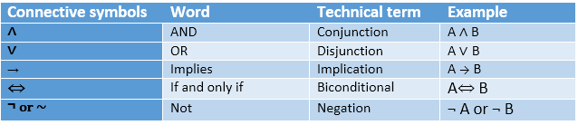
Example sentences in PL
Examples: Convert from English to Propositional sentence
Let A = Lectures are active and R = Text is readable, P = Kebede will pass the exam, then represent the following:
the lectures are not active:
the lectures are active and the text is readable:
either the lectures are active or the text is readable:
if the lectures are active, then the text is not readable:
the lectures are active if and only if the text is readable:
if the lectures are active, then if the text is not readable, Kebede will not pass the exam:
¬A
A ∧ R
A V R
A → ¬ R
A ↔ R
A → (¬R → ¬P )

Slide 32
Terminology
Valid sentence: A sentence is valid sentence or tautology if and only if it is True under all possible interpretations in all possible worlds.
Example: “It’s raining or it’s not raining.” (R ∨ ¬R)
Satisfiable: A sentence is satisfaible if and only if there is some interpretations in some world for which the sentence is True.
Example: “It is raining or it is humid”. R v Q, R
Unsatisfiable: A sentence is unsatisfiable (inconsistent sentence or self-contradiction) if and only if it is not satisfiable, i.e. a sentence that is False under all interpretations. The world is never like what it describes.
Example: “It’s raining and it's not raining.” R ∧ ¬R

Slide 33
Conti..
Entailment: mirrors the relation of one fact following from another.
New sentences are generated that are necessarily true, given that the old sentences are true.
KB entails α (KB |= α) if and only if the conclusion α is true in every logically possible worlds in which all the premises in KB are true.
Derivation:
KB |- Q, Q is derived from KB if there is a proof consisting of a sequence of valid inference steps starting from the premises in KB and resulting in Q.

Slide 34
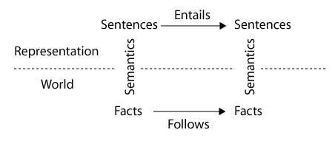
Semantics
It is all about facts and their representation:
Facts are part of the world, where as their representation must be encoded in some way that can be physically stored within an agent.
A semantics maps sentences to facts in the world.
In the simplest case,
Semantics determines what objects in the world are referenced by which objects in the language.
The property of one fact following from another should be mirrored by the property of one sentence being logically entailed by another.

Slide 35
Conti…
Semantics specifies the interpretation of the proposition symbols & constants, and the meanings of the logical connectives.
Truth Tables: define the semantics of sentences.
The following table shows truth table for the five logical connectives. Note: P and Q can be any sentence, including complex sentences.
P | Q | ¬P | P ∧Q | P ∨Q | P →Q | P ↔Q
True | True | False | True | True | True | True
True | False | False | False | True | False | False
False | True | True | False | True | True | False
False | False | True | False | False | True | True
Sentences in propositional logic tell you about what is true or false.
P  Q means that both P and Q are true.
P  Q means that either P or Q is true (or both)
P  Q means that if P is true, so is Q.

Slide 36
Conti..
Complex sentences such as (R∧S)→(¬R∨S) are defined by a process of decomposition.
First determine the meaning of (R∧S) and of (¬R∨S).
Then combine them using the definition of the → function
R | S | ¬R | R∧S | ¬R∨S | (R∧S)→(¬R∨S)
True | True | False | True | True | True
True | False | False | False | False | True
False | True | True | False | True | True
False | False | True | False | True | True

Slide 37
Activity!
Write the truth table for:
(P → Q) → (R → ¬P) ?

Slide 38
Quiz!
Suppose that the statement p → ¬q is false. Find all combinations of truth values of r and s for which (¬q → r) ∧ (¬p ∨ s) is True.
If the statement q ∧ r is true, determine all combinations of truth values for p and s such that the statement (q → [¬p ∨ s]) ∧ [¬s → r] is True.
Find all combinations of truth values for p, q and r for which the statement ¬p ↔ (q ∧ ¬(p → r)) is True.

Slide 39
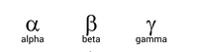
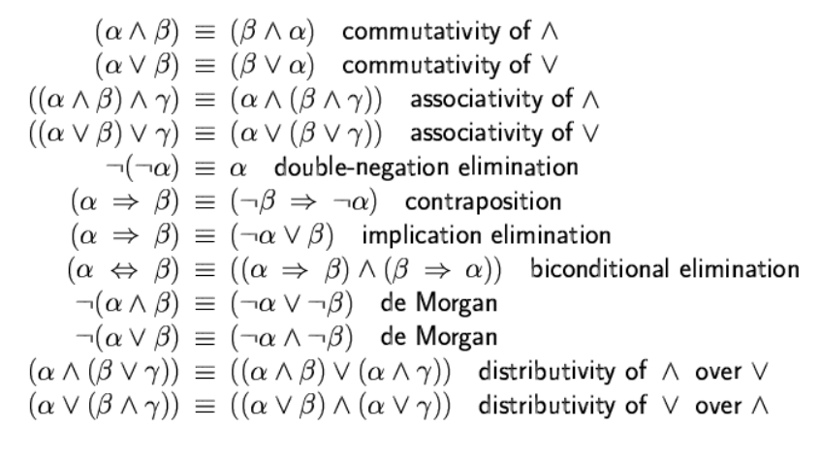
Logical Equivalence
Two sentences are logical equivalent iff they are true in same models: α Ξ β if and only if α |= β and β |= α .
The notation α |= β means that if α is true, then β must also be true. It is read as "entails" or "logically implies".

Slide 40
|= vs. |-
|-
|=
In propositional logic, the symbol |- is used to represent the concept of "deduction" or "derivation". It is read as "entails" or "proves".
The notation Γ |- A means that the formula A can be derived or deduced from the set of formulas Γ using the rules of inference.
In other words, if all the formulas in Γ are true, then A must also be true.
For example, if Γ represents the set of formulas "All men are mortal" and "Socrates is a man", then Γ |- "Socrates is mortal" means that we can deduce or prove that Socrates is mortal from the premises "All men are mortal" and "Socrates is a man" using the rules of inference.
In propositional logic, the symbol |= is used to represent the concept of "entailment". It is read as "entails" or "logically implies".
The notation A |= B means that if A is true, then B must also be true.
In other words, A logically implies B. This is also known as a tautology, where the truth of A necessarily implies the truth of B.
For example, if A represents the statement "All men are mortal" and B represents the statement "Socrates is a man", then A |= B means that if it is true that all men are mortal, then it logically follows that Socrates is mortal.
Gamma → (uppercase Γ, lowercase γ; )

Slide 41
Inference Rules
Inference rules are logical rules that allow us to derive new knowledge or conclusions from existing knowledge or premises.
Inference rules are used in deductive reasoning, which is a method of reasoning that starts with general principles or premises and draws specific conclusions from them.

Slide 42
Conti..
Inference is used to create new sentences that are logically drawn from a given set of sentences in the KB.
It captures patterns of inferences that occur over & over again.
Once a rule is established, it can be used to make inferences without going through the tedious process of building truth tables.
An inference rule {α, β} |- Θ consists of two sentence patterns:
α & β called the conditions (premises) and,
Θ called the conclusion.
If α & β match two sentences of KB, then the corresponding Θ can be inferred according to the rule.
Given set of inference rules (I) and set of sentences (KB);
Inference is the process of applying successive inference rules from given set of inference rules (I) to set of sentences (KB), each rule inferring new facts and adding its conclusion to KB.
Example: Modus Ponens: { α⇒β , α } |- β

Slide 43
Common inference rules
Key: A = It rains, B:=The ground will be wet , C =The grass will be slippery
1. Modus Ponens: If A implies B and A is true, then B must be true.
For example, if "If it rains, the ground will be wet" and "It is raining" are true, then we can infer that "The ground is wet" is true. ((A →B, A) → B) or ((A →B) ∧ A) → B)
2. Modus Tollens: If A implies B and B is false, then A must be false.
For example, if "If it rains, the ground will be wet" is true and "The ground is not wet" is true, then we can infer that "It is not raining" is true. ((A →B, ¬B) → ¬A)
3. Hypothetical Syllogism: If A implies B and B implies C, then A implies C.
For example, if "If it rains, the ground will be wet" implies "If the ground is wet, the grass will be slippery" and "If the grass is slippery, people may fall" implies "If it rains, people may fall", then we can infer that "If it rains, people may fall" is true. ((A →B) ∧ (B→ C) ) → (A → C)
4. Disjunctive Syllogism: If A or B is true, and A is false, then B must be true.
For example, if "Either it will rain or it will snow" is true and "It will not rain" is true, then we can infer that "It will snow" is true. ((A ∨ B) ∧ ¬A ) → B
5. Addition: If A is true, then A or B is true.
For example, if "It is raining" is true, then we can infer that "It is raining or the sun is shining" is true.
(A → (A∨ B)

Slide 44
Conti..
RULE | PREMISE | CONCLUSION
Modus Ponens | A, A → B | B
Modus Tolens | ¬B, A → B | ¬A
And Elimination | A ∧ B | A
And Introduction | A, B | A ∧ B
Or Introduction | A | A₁ ∨ A₂ ∨… ∨ A_{n}
Double Negation Elimination | ¬ ¬A | A
Unit Resolution | A ∨ B, ¬B | A
Resolution | A ∨ B, ¬B ∨ C | A ∨ C
Hypothetical Syllogism | P→Q, Q→R | P→R

Slide 45
Two important properties of inference Completeness and Soundness
Completeness: If KB |- Q then KB |= Q
A logic is complete if it is capable of proving all consequences that can be represented in it.
If Q is derived by a set of sentences in KB, then Q can be entailed from KB using inference rules.
Hence, inference produces all entailments, or all valid sentences can be proved from the premises.
A set of inference rules is complete if every entailed sentences can be obtained by applying some finite succession of these rules.

Slide 46
The statement "If KB |- Q then KB |= Q" is known as the completeness theorem in propositional logic.
It states that if a proposition Q can be derived from a knowledge base (KB) using valid inference rules (represented as KB |- Q), then Q is logically entailed by KB (represented as KB |= Q).
In other words, if Q can be derived from KB using valid inference rules, then Q must be true whenever all the premises in KB are true. This is an important property of propositional logic, as it ensures that any proposition that can be derived from a set of premises using valid inference rules is necessarily true if the premises are true.
For example, suppose we have a knowledge base KB that contains the premises "if it is raining, then the ground is wet" (represented as R → W) and "it is raining" (represented as R). We can use Modus Ponens to derive the conclusion "the ground is wet" (represented as W) from these premises. Therefore, we can say that "the ground is wet" is logically entailed by KB (represented as KB |= W), and we can also say that there exists a proof that derives "the ground is wet" from the premises of KB (represented as KB |- W).
In symbolic notation, we can represent this as follows:
Premises:
KB = { R → W, R }
KB |- W
Conclusion:
KB |= W
Therefore, we can conclude that if a proposition Q can be derived from a knowledge base KB using valid inference rules, then Q is logically entailed by KB.

Slide 47
Conti..
Soundness: If KB |= Q then KB |- Q
A logic is sound if it preserves truth (i.e. if a set of premises are all true, any conclusion drawn from those premises must also be true).
If Q is entailed from a set of sentences KB using a given set of rules of inference, then Q is derived by KB.
Hence, inference produces only real entailments, or any sentence that follows deductively from the premises is valid.
An inference rule is sound if it generates only entailed sentences.
All inference rules previously given are sound.
A rule is sound if its conclusion is true whenever the premise is true.
E.g. modus ponens: {α ⇒ β , α} β
⊥

Slide 48
The statement "If KB |= Q then KB |- Q" is known as the soundness theorem in propositional logic. It states that if a knowledge base (KB) logically entails a proposition Q (represented as KB |= Q), then there exists a proof that derives Q from the axioms and inference rules of propositional logic (represented as KB |- Q).
In other words, if KB logically entails Q, then Q can be derived from KB using valid inference rules. This is an important property of propositional logic, as it ensures that any conclusion drawn from a set of premises using valid inference rules is necessarily true if the premises are true.
For example, suppose we have a knowledge base KB that contains the premises "if it is raining, then the ground is wet" (represented as R → W) and "it is raining" (represented as R). We can use Modus Ponens to derive the conclusion "the ground is wet" (represented as W) from these premises. Therefore, we can say that KB logically entails the proposition "the ground is wet" (represented as KB |= W), and we can also say that there exists a proof that derives "the ground is wet" from the premises of KB (represented as KB |- W).
In symbolic notation, we can represent this as follows:
Premises:
KB = { R → W, R }
KB |= W
Conclusion:
KB |- W
Therefore, we can conclude that if KB logically entails a proposition Q, then there exists a proof that derives Q from the axioms and inference rules of propositional logic.

Slide 49
Example 1
From: Engine-Starts ∨ Car-OK
¬ Car-OK
Infer: Engine-Starts
Unit resolution
Modus Ponens
From: Engine-Starts,
Engine-Starts → Car-OK
Infer: Car-OK
From: ¬ Car-OK
Engine-Starts → Car-OK
Infer: ¬Engine-Starts
Modus Tolens
RULE | PREMISE | CONCLUSION
Modus Ponens | A, A → B | B
Modus Tolens | ¬B, A → B | ¬A
Unit Resolution | A ∨ B, ¬B | A
Key:
A: Engine-Starts
B: Car-OK

Slide 50
Example 2
RULE | PREMISE | CONCLUSION
Resolution | A ∨ B, ¬B ∨ C | A ∨ C
Hypothetical Syllogism | P→Q, Q→R | P→R
Keys - A: Engine-Starts, B: Car-OK , C:Flat-Tire
Resolution
From:
Engine-Starts ∨ Car-OK, ¬ Car-OK ∨ Flat-Tire
Infer: Engine-Starts ∨ Flat-Tire
Hypothetical syllogism
From:
Engine-Starts → Car-OK, Car-OK → Flat-Tire
Infer: Engine-Starts →Flat-Tire

Slide 51
Formal Proofs
A proof is a sequence of steps followed to generate sentences, where each sentence is:
Either a premise or a sentence/formula derived from earlier sentences (of the proof) using some of the rules of inference.
The last step of the proof should deduce the formula (also called goal or query) that we want to prove.
Example: The “weather problem”. Proof whether it is raining or not.
Can you proof using tree representation?
1 Q Premise “It is humid”
2 Q → P Premise “If it is humid, it is hot”
3 (P∧Q) → R Premise “If it’s hot & humid, it’s raining”

Slide 52
Cont..
Example: The “weather problem”. Proof whether it is raining or not.
Can you proof using tree representation?
(Hint: apply inference rules like Modus Ponens, And Introduction)
1 Q Premise “It is humid”
2 Q → P Premise “If it is humid, it is hot”
3 P Modus Ponens(1,2) “It is hot”
4 (P∧Q) → R Premise “If it’s hot & humid, it’s raining”
5 P∧Q And Introduction(1,2) “It is hot and humid”
6 R Modus Ponens(4,5) “It is raining”
Key:
Q: It is humid
P: it is hot
R: it’s raining

Slide 53
Examples 3
Represent the following problem and infer the third sentence from the first two:
Every person is mortal.
Socrates is a person.
Therefore, Socrates is mortal.
In PL use propositional symbols to stand for all or part of each sentence. Hence,
P = “person”; M = “mortal”; S = “Socrates”
So the above sentences are represented as:
P → M, S→ P (Hypothesis). We can infer: S → M
Although the third sentence is entailed by the first two, we need an explicit symbol, S, to represent an individual, Socrates, who is a member of the classes “person” and “mortal.”
To represent other individuals we must introduce separate symbols for each one, which means for representing the fact that all individuals who are “people” are also "mortal.”

Slide 54
Activity!
Construct formal proof of validity for the following problem:
If the investigation continues, then new evidence is brought to light. If new evidence is brought to light, then several leading citizens are implicated. If several leading citizens are implicated, then the newspapers stop publicizing the case. If continuation of the investigation implies that the newspapers stop publicizing the case, then the bringing to light of new evidence implies that the investigation continues. The investigation does not continue. Therefore, new evidence is not brought to light.
Represent using PL and proof the conclusion that “new evidence is not brought to light”.
Let's represent the statements using propositional logic:
P: The investigation continues
Q: New evidence is brought to light
R: Several leading citizens are implicated
S: The newspapers stop publicizing the case
The given premises can be represented as:
P → Q
Q → R
R → S
(P → S) → (Q → P)
¬P
Prove: ¬Q

Slide 55
Let's represent the statements using propositional logic:
P: The investigation continues
Q: New evidence is brought to light
R: Several leading citizens are implicated
S: The newspapers stop publicizing the case
The given premises can be represented as:
P → Q
Q → R
R → S
(P → S) → (Q → P)
¬P
Prove: ¬Q

Slide 56
Solution 1
Let's represent the statements using propositional logic:
P: The investigation continues
Q: New evidence is brought to light
R: Several leading citizens are implicated
S: The newspapers stop publicizing the case
The given premises can be represented as:
P → Q
Q → R
R → S
(P → S) → (Q → P)
¬P
To prove that "new evidence is not brought to light" (¬Q), we will assume the opposite, i.e., Q, and derive a contradiction.
Assume Q:
From (2), we can infer R: R (modus ponens)
From (3), we can infer S: S (modus ponens)
From (4), we can infer (Q → P): (P → S) → (Q → P) (modus ponens)
From (1), we can infer (P → Q): P → Q (premise)
Using hypothetical syllogism, we can infer (P → P): (P → Q) ∧ (Q → R) → (P → R)
Using modus ponens, we can infer P: P (P → P)
But this contradicts premise (5), which states that ¬P. Therefore, our assumption that Q is false, and we can conclude that "new evidence is not brought to light" (¬Q).
Hence, we have proved that if the investigation does not continue, then new evidence is not brought to light.

Slide 57
Solution 2
**Proof:**
1. P → Q (Premise 1)
2. Q → R (Premise 2)
3. R → S (Premise 3)
4. P → S (Premise 4)
5. ¬P (Premise 5)
6. ¬P → ¬S (1, Modus Ponens)
7. ¬S (5, 6, Modus Tollens)
8. ¬Q (3, 7, Modus Tollens)
Therefore, the conclusion is true.
**Premises:**
1. P → Q
2. Q → R
3. R → S
4. P → S
5. ¬P
**Conclusion:**
6. ¬Q

Slide 58
Solution 3
Proof:
P → Q (Premise)
Q → R (Premise)
R → S (Premise)
(P → S) → (Q → P) (Premise)
¬P (Premise)
¬(P → S) ∨ (Q → P) (Material implication of 4)
¬(¬S → ¬P) ∨ (Q → P) (Contrapositive of 6)
(¬¬S ∧ ¬¬P) ∨ (Q → P) (De Morgan's Law on 7)
(S ∧ P) ∨ (Q → P) (Double Negation on 8)
¬(S ∧ P) → (Q → P) (Material Implication on 9)
¬S ∨ ¬P → (Q → P) (De Morgan's Law on 10)
¬S ∨ ¬P → (¬Q ∨ P) (Material Implication on 1)
(¬S ∨ ¬P) ∧ (¬S ∨ P ∨ ¬Q) (Distribution on 12)
(¬S ∨ ¬P) ∧ (P ∨ ¬Q ∨ ¬S) (Commutativity on 13)
¬S ∨ ¬P (Simplification on 14)
¬P (Resolution on 5 and 15)
¬Q (Modus Tollens on 10 and 16)
Therefore, we have proved that if the investigation does not continue, then new evidence is not brought to light, using propositional logic.

Slide 59
Exercise!
Socrates is either intelligent or a good actor. If Socrates is intelligent, then he can count from 1 to 10. Socrates can only count fom 1 to 2. Therefore Socrates is a good actor.
Represent using PL and proof the conclusion that Socrates is a good actor or not.

Slide 60
PL is a weak language _{Why?}
There are several limitations of propositional logic (PL), which include:
Limited Expressiveness: PL is limited in its ability to express complex relationships between objects. It cannot express quantifiers such as "all" or "some", which are essential for expressing many real-world problems.
Inability to Handle Uncertainty: PL cannot handle uncertainty or probability. It assumes that all propositions are either true or false, which is not always the case in real-world problems.
No Ability to Represent Time: PL cannot represent the temporal relationships between events. It cannot express the order in which events occur or the duration of events.
No Ability to Represent Change: PL cannot represent change or dynamic systems. It cannot express how the state of a system changes over time.
No Ability to Represent Context: PL cannot represent context or background knowledge. It cannot take into account the knowledge that is already known about a problem.
No Ability to Handle Inconsistency: PL cannot handle inconsistent or contradictory information. It assumes that all propositions are consistent, which is not always the case in real-world problems.
These limitations make propositional logic unsuitable for many real-world problems, which require more expressive and flexible formalisms such as first-order logic (FOL).

Slide 61
Conclusion
Due to the ambiguity in natural languages there is a need to specify knowledge through the use of formal languages.
Formal languages give us a way to remove ambiguity and provide methods for automating inference. PL is a first move in this direction.
Inference: The process of deriving new sentences from old one .
Sound inference: derives true conclusions given true premises.
Complete inference: derives all true conclusions from a set of premises.
A valid sentence is true in all worlds under all interpretations.
If an implication sentence can be shown to be valid, then
given its premise - its consequent can be derived.
PL commits only to the existence of facts that may or may not be the case in the world being represented.
Using a simple syntax and semantic, it illustrates the process of inference.
PL quickly becomes impractical, even for very small worlds.

Slide 62
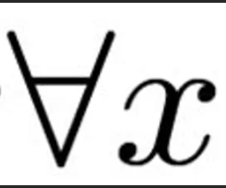
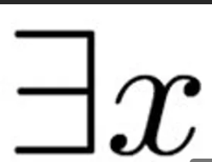
Predicate (First Order) Logic

Slide 63
First Order Logic (FOL)
What are Propositional Logic (PL) limitations?
PL isn’t powerful enough as a general KR language.
Impossible to make general statements.
Example:
all students sit for exams .
if any student sits for an exam, he either pass or fail.
FOL is a more powerful form of logic than PL because it allows for the representation of more complex statements and relationships between objects and concepts.
FOL includes quantifiers (such as "for all" and "there exists") and variables, which allow for the expression of statements about specific objects or groups of objects.
Almost any English sentence may be represented in first-order predicate calculus.

Slide 64

Conti..
FOL (like natural language) assumes the world contains:
Objects: that have attributes/properties:
People, house, number, color, baseball-game, war, and etc.
Relations: between objects:
Brother-of, bigger-than, part-of, and etc.
Properties: distinguishing features.
Color (red), shape (round), size (length), and etc.
Functions: returns value for a given object:
Father-of, best-friend, cosine, plus, and etc.
Almost any fact refers to objects & relations/properties.
Example: King John ruled England in 1200
Objects: John, England, 1200
Relations: ruled
Properties: king

Slide 65
Syntax of FOL
Constants Symbol
Names (like Jonas, Kebede, …), Numbers (like 1, 2, … n), ...
Predicates:
Predicates used to relate one object with another. E.g. brother, >,...
Functions:
Returns value (Sqrt, mother-of,...)
Variables:
x, y, a, b,...
Important to increase generalization capability of KB.
Connectives:
Retains connectives used in PL (¬, ⇒, ∧, ∨, ⇔)
Equality: =
Quantifiers:
Quantifiers specify whether all or some objects satisfy properties or relations between objects.
Two standard quantifiers:
Universal ( ∀_{X} | For all, for every) and
Existential ( ∃x | There exists, some)

Slide 66
Examples of FOL
1. John’s mother is married to John’s father.
This statement represents the fact that John's mother is married to John's father.
The predicate "married" takes two arguments, which are the father of John and the mother of John, respectively.
This statement can be read as:
"married(father(john), mother(john))".
2. Potato is good and Potato is a kind of food.
This statement represents the fact that potato is good and that potato is a kind of food.
The predicate "good" takes one argument, which is potato.
The predicate "is" takes two arguments, which are potato and food.
This statement can be written as: "good(Potato) ∧ is(Potato, food)" or "good(Potato) ∧ food(Potato)".
3. All food are edible.
This statement represents the fact that all food is edible.
The universal quantifier "∀" is used to indicate that the statement applies to all objects in the domain.
The variable "X" represents an arbitrary object in the domain.
The predicates "food" and "edible" represent the properties of being food and being edible, respectively.
This statement can be written as:
"∀_{X} (food(X) → edible(X))".

Slide 67
More..
Let's say we have a domain of objects that includes people, and we want to express the statement "All people are mortal." How we can represent this statement in FOL?
∀x (Person(x) → Mortal(x))
In this statement,
The universal quantifier (∀) indicates that the statement applies to all objects in the domain.
The variable x represents an arbitrary object in the domain, and
The predicate Person(x) represents the property of being a person.
The arrow (→) represents implication, so the statement "Person(x) → Mortal(x)" means that if x is a person, then x is mortal.
Finally, the predicate Mortal(x) represents the property of being mortal.
This statement can be read as "For all x, if x is a person, then x is mortal."
It expresses the idea that mortality is a property that all people share.

Slide 68

Universal Quantification
Universal Quantifiers: makes statements about every object.
∀<variables> <sentence>
Everyone at WKU is smart:
∀_{x} At(x, WKU) ⇒ Smart(x)
All cats are mammals:
∀_{x} cat(x) ⇒ mammal(x)
∀_{x} sentence P is true iff P is true with being each possible object in the given universe.
The above statement is equivalent to the Conjunction
At(Eyob, WKU) ⇒ Smart(Eyob) ∧
At(Surafel, WKU) ⇒ Smart(Surafel) ∧
...
A common mistake to avoid
Typically, ⇒ is the main connective with ∀ but the most common mistake is the use of ∧ as the main connective with ∀.
∀_{x} At(x,WKU) ∧ Smart(x) is true if “Everyone is at WKU & everyone is smart”

Slide 69

Existential Quantification
Existential Quantifiers: makes statements about some objects in the universe.
∃<variables> <sentence>
Someone at WKU is smart:
∃_{x} At(x, WKU) ∧ Smart(x)
Spot has a sister who is a cat:
∃_{x} sister(spot, x) ∧ cat(x)
∃_{x} sentence P is true iff P is true with x being some possible objects.
The above statement is equivalent to the Disjunction
At(Rehobot, WKU) ∧ Smart(Rehobot) ∨
At(Merana, WKU) ∧ Smart(Merana) ∨
…..
Common mistake to avoid
Typically, ∧ is the main connective with ∃ but the most common mistake is using ⇒ as the main connective with ∃:
∃_{x} At(x, WKU) ⇒ Smart(x) is true if there is anyone who is not at WKU

Slide 70
Nested Quantifiers
∀_{x,y} parent(x,y) ⇒ child(y,x) Can you translate it to English sentence?
For all x and y, if x is the parent of y then y is the child of x.
∃_{x} ∀_{y} Loves(x,y)
There is a person who loves everyone in the given world.
∀_{y} ∃_{x} Loves(x,y)
Everyone in the given universe is loved by at least one person.
Properties of quantifiers
∀_{x} ∀_{y} is the same as ∀_{y} ∀_{x}
∃_{x} ∃_{y} is the same as ∃_{y} ∃_{x}
∃_{x} ∀_{y} is not the same as ∀_{y} ∃_{x}
Quantifier duality: each can be expressed using the other, using negation (¬).
∀_{x} Likes(x, ice-cream) ¬∃_{x} ¬Likes(x, ice-cream) Can you translate it to English sentence?
Everyone likes ice cream means that there is nobody who dislikes ice cream.
∃_{x} Likes(x, cake) ¬∀_{x} ¬Likes(x, cake)
There is someone who likes cake means that there is no one who dislikes cake.

Slide 71
Conti..
De Morgan's rules for quantified sentences are as follows:
1. De Morgan's rule for negation of universal quantification:
¬(∀x P(x)) ⇔ ∃x ¬P(x)
This rule states that the negation of a universal quantification is equivalent to the existence of at least one object for which the predicate is false.
2. De Morgan's rule for negation of existential quantification:
¬(∃x P(x)) ⇔ ∀x ¬P(x)
This rule states that the negation of an existential quantification is equivalent to the assertion that the predicate is false for all objects.
3. Quantifier exchange for universal quantification:
(∀x P(x)) ⇔ (∀y P(y))
This rule states that we can replace the variable of a universal quantification with any other variable without changing the meaning of the sentence.
4. Quantifier exchange for existential quantification:
(∃x P(x)) ⇔ (∃y P(y))
This rule states that we can replace the variable of an existential quantification with any other variable without changing the meaning of the sentence.
5. Distributivity of conjunction over universal quantification:
(∀x (P(x) ∧ Q(x))) ⇔ (∀x P(x) ∧ ∀x Q(x))
This rule states that we can distribute the conjunction over a universal quantification.
6. Distributivity of disjunction over existential quantification:
(∃x (P(x) ∨ Q(x))) ⇔ (∃x P(x) ∨ ∃x Q(x))
This rule states that we can distribute the disjunction over an existential quantification.

Slide 72
Conti..
Equality
term₁ = term₂ is true under a given interpretation if and only if term₁ and term₂ refer to the same object.
E.g., definition of Sibling in terms of Parent:
∀_{x, y} Sibling (x, y) ⇔ [¬(x = y) ∧ ∃_{m, f} ¬(m = f) ∧ Parent(m, x) ∧ Parent(f, x) ∧ Parent(m, y) ∧ Parent(f, y)]
For any two individuals x and y, they are siblings if and only if the following conditions hold:
1. x and y are not the same individual (¬(x = y)).
2. There exist two individuals m and f who are not the same individual (¬(m = f)), such that:
a. m is a parent of x (Parent(m, x)).
b. f is a parent of x (Parent(f, x)).
c. m is a parent of y (Parent(m, y)).
d. f is a parent of y (Parent(f, y)).
In other words, two individuals are sibling if and only if they have at least one pair of parents in common, and they are not the same individual.

Slide 73
Translating English to FOL
Activity!
Every gardener likes the sun.
(∀x) gardener(x) ⇒ likes(x, Sun)
Not Every gardener likes the sun.
¬((∀x) gardener(x) ⇒ likes(x, Sun))
You can fool some of the people all of the time.
(∃x)(∀t) person(x) ^ time(t) ⇒ can-be-fooled(x, t)
You can fool all of the people some of the time.
(∀x)(∃t) person(x) ^ time(t) ⇒ can-be-fooled(x, t)
(the time people are fooled may be different)
You can fool all of the people at some time.
(∃t)(∀x) person(x) ^ time(t) ⇒ can-be-fooled(x, t)
(all people are fooled at the same time)
You can not fool all of the people all of the time.
¬((∀x)(∀t) person(x) ^ time(t) ⇒ can-be-fooled(x, t))
Everyone is younger than his father
(∀x) person(x) ⇒ younger(x, father(x))
All purple mushrooms are poisonous.
(∀x) (mushroom(x) ^ purple(x)) ⇒ poisonous(x)
No purple mushroom is poisonous.
¬(∃x) purple(x) ^ mushroom(x) ^ poisonous(x)
(∀x) (mushroom(x) ^ purple(x)) ⇒¬poisonous(x)
There are exactly two purple mushrooms.
(∃x)(Ey) mushroom(x) ^ purple(x) ^ mushroom(y) ^ purple(y) ^ ¬ (x=y) ^
(∀z) (mushroom(z) ^ purple(z)) ⇒((x=z) v (y=z))
Clinton is not tall.
¬tall(Clinton)
X is above Y if X is directly on top of Y or there is a pile of one or more other objects directly on top of one another starting with X and ending with Y.
(∀x)(∀y) above(x, y) ⇔ (on(x,y) v (∃z) (on(x, z) ^ above(z, y)))

Slide 74
Sentence Structure
In FOL the basic unit is a Predicate (Argument/Terms) structure which is called sentence to represent facts.
Terms refers to objects
Example: likes(Muna, Chocolate); tall(Abdi);
Terms or arguments can be any of:
Constant symbol, such as ‘Sitra’, Variable symbol, such as X , Functions, such as mother-of(Ayub), father-of(father-of(Wendmayehu)).
A predicate is the one that says something about the subject. E.g., The book is red.
Subject: Color of the book, Represented as: is-red(book).
is-red: Predicate, and book: Argument.
Predicate also refers to a particular relation between objects.
Example: likes(X, Tamiru)
friends(mother-of(Tigistu), mother-of(Behailu))
A predicate statement takes the value true or false.

Slide 75
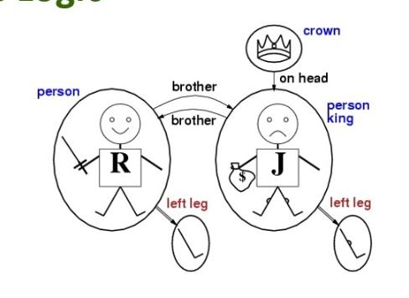
Sentences
Atomic sentences: formed from a predicate symbol followed by a parenthesized list of terms.
Atomic sentence = predicate (term₁,..., term_{n})
Example: Brother(Natan, Yesuf)
Atomic sentences can have arguments that are complex terms.
Term = function (term₁,...,term_{n}) )
Example: married(fatherof(Seifu),motherof(Adane))
Complex sentences: they are made by combining atomic sentences using connectives:
¬S, S₁ ∧ S₂, S₁ ∨ S₂, S₁ ⇒ S₂, S₁ ⇔ S₂,
Example
likes(John, Mary) V tall(Mary)
tall(John) V handsome(John)
Sibling(John, Richard) ⇒ Sibling(Richard, John)
Sentences can also be formed using quantifiers to indicate how to treat variables:
Universal quantifier: x lovely(x) - Everything is lovely.
Existential quantifier: x lovely(x) - Something is lovely.

Slide 76
Semantics
There is a precise meaning to expressions in predicate logic.
Like in propositional logic, it is all about determining whether something is true or false.
x P(x) means that P(x) must be true for every object x in the domain of interest.
x P(x) means that P(x) must be true for at least one object x in the domain of interest.
So if we have a domain of interest consisting of just two people, John and Mary, and we know that tall(Mary) and tall(John) are true, we can say that x tall(x) is true.
Atomic sentence is true if the relation referred by the predicate holds between the objects referred by the arguments.
brother(John, Richard)
The truth value of complex sentences depends on logical connectives used.
older(John,30) ⇒ ¬younger(John,30)

Slide 77
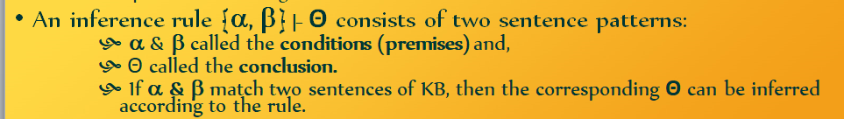
Inference in First Order Logic
We saw inference rules for propositional logic, these rules hold for first-order logic as well.
We, however, need additional inference rules to handle 1st order logic sentence with quantifiers.
We can define inference rules allowing us to say that if certain things are true, certain other things are sure to be true,
E.g. All men are mortal
Aristotle is a man
Using logical inferences we can deduce that:
Aristotle is mortal

Slide 78
Sound Inference Rules
Rules for PL apply to FOL as well.
For example, Modus Ponens, And-Introduction, And-Elimination, etc.
New (sound) inference rules for use with quantifiers:
Universal Elimination, Existential Introduction, Existential Elimination
By substituting particular individuals for the variable.
E.g. substitute (x/sam, y/cake). Then likes(x, y) = likes(sam,cake)
Universal Elimination: If "x P(x) is true, then P(c) is true, where c is a constant in the domain of x.
Example: "x eats(x, IceCream).
Using the substitution (x/Alex) we can infer eats(Alex, Icecream).
The variable symbol can be replaced by any constant symbol or function symbol.

Slide 79
Conti..
Existential Introduction: If P(c) is true, then $x P(x) is inferred.
Example: eats(John, IceCream) we can infer $x eats(x, icecream).
All instances of the given constant symbol are replaced by the new variable symbol.
Existential Elimination: From $x P(x) infer P(c).
Example: $x eats(Sol, x) infer eats(Sol, Cheese)
Note that the variable x is replaced by a brand new constant (like Cheese) that does not occur in this or any other sentence in the Knowledge Base.

Slide 80
Proofs
Sound inference: find α such that KB |= α
Proof process is a search, operators are inference rules.
It requires the operation of a series of inference rule to come up with some conclusion.
Example:
Bob is a buffalo. Pat is a pig. Buffaloes outrun pigs.
Conclude: Bob outruns Pat.
1. Buffalo(Bob)
2. Pig(Pat)
3. ∀x,y Buffalo(x) ^ Pig(y) → Faster(x,y)
4. Buffalo(Bob) ^ Pig(Pat) And Introduction (1, 2)
5. Buffalo(Bob) ^ Pig(Pat) → Faster(Bob, Pat)
Universal Elimination (3, {x/Bob,y/Pat})
6. Faster(Bob,Pat) Modus Ponens (6, 7)

Slide 81
Conclude by Chaining
Forward chaining
Proofs start with the given axioms/premises in KB, deriving new sentences using Generalized Modus Ponens (GMP)​​ until the goal/query sentence is derived.
This defines a forward chaining inference procedure because it moves "forward" from the KB to the goal.
Backward chaining:
Proofs start with the goal query, find implications that would allow you to prove it, and then prove each of the antecedents in the implication, continuing to work "backwards" until we get to the axioms, which we know are true.

Slide 82
Building a KB
We have seen that first order logic is a powerful tool for knowledge representation and reasoning.
Logic does not offer guidance as to what facts should be expressed, nor does it give a guide on what vocabulary should be used to express them.
Process of building a knowledge base is called knowledge engineering.

Slide 83
Knowledge Engineer
A person who
Investigates a particular domain.
Determines what concepts are important in the domain.
Creates a formal representation of objects and relations in the domain.
Is trained in representation but is not an expert.
Usually interviews the real experts to become educated about the domain and to get the required knowledge (process of knowledge acquisition).

Slide 84
Conti..
Interviewing occurs before or along with the process of creating formal representation.
One does not become proficient knowledge engineer just by studying the syntax and semantics of a representation language.
It takes practice and exposure.

Slide 85
Criteria of good KBs
A knowledge base should be clear and correct.
The representation language in the knowledge base should be expressive, concise, unambiguous, and effective.
Relations should be relevant.
Knowledge base and inference procedure should be clearly maintained/separated.
What ever language you use to represent the knowledge, the inference procedure should provide the same answer.

Slide 86
Common mistake in the KB
Common mistake is to choose predicate names that are meaningful to the human reader and to assume that the name would be meaningful to the inference procedure as well.
Eg. Pooh is a type of bear who has a very small brain.
BearofVerySmallbrain(pooh)

Slide 87
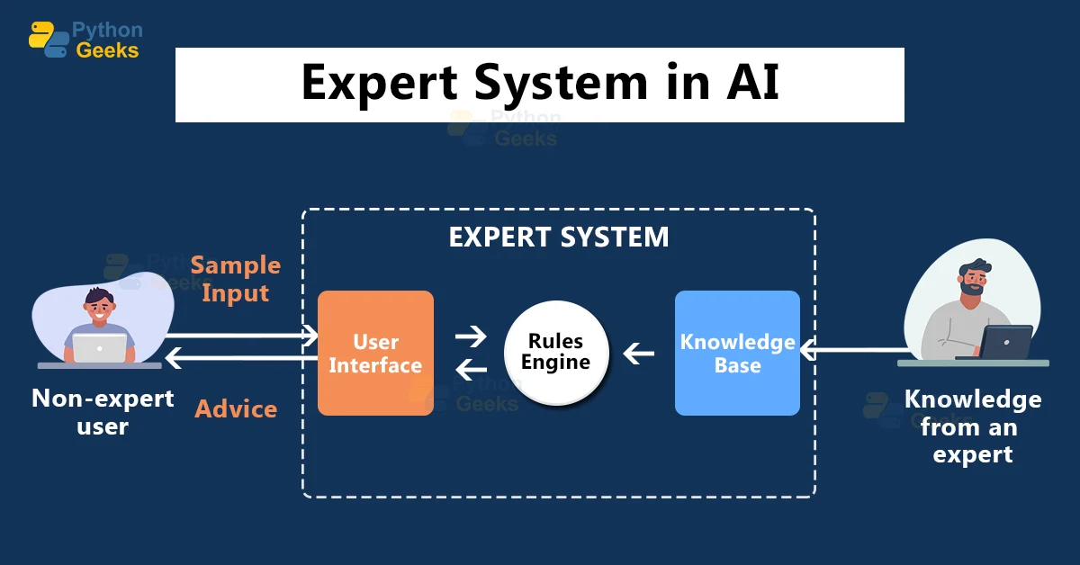
Expert System

Slide 88
What is an Expert system?
Expert systems are a type of artificial intelligence (AI) that are designed to mimic the decision-making abilities of a human expert in a particular domain. They are computer programs that use a knowledge base of facts and rules, along with an inference engine, to reason about a problem and provide advice or recommendations.
Definition (1):
An experts system is a computer program that contains stored knowledge and solves problems in a specified field in much the same way that human expert would.
The knowledge typically comes from a series of conversations between the developer of the expert system and one or more experts.
The completed system applies the knowledge to problems specified by the user.

Slide 89
Conti..
Definition (2):
An expert system is a computer program that is designed to hold the accumulated knowledge of one or more domain experts.
A computer program that represents and reasons with knowledge of some subject specialist with a view to solving problems or giving advice.
An expert system is a computer program that simulates the reasoning of a human expert in a certain domain. To do this, it uses a knowledge base containing facts and heuristic and some inference procedure for utilizing its knowledge.
Expert systems are computer programs that attempt to replicate the performance of a human expert on some specialised reasoning task.
Also called knowledge based systems, they are able to store and manipulate knowledge so that they can help a user to solve a problem or make a decision.

Slide 90
Conti..
The main features of an expert system are:
It is limited to a specific domain (area of expertise).
It is typically rule based.
It can reason with uncertain data.
It can represent heuristics and uncertain information.
It delivers advice.
It explains its reasoning and results to the user.

Slide 91
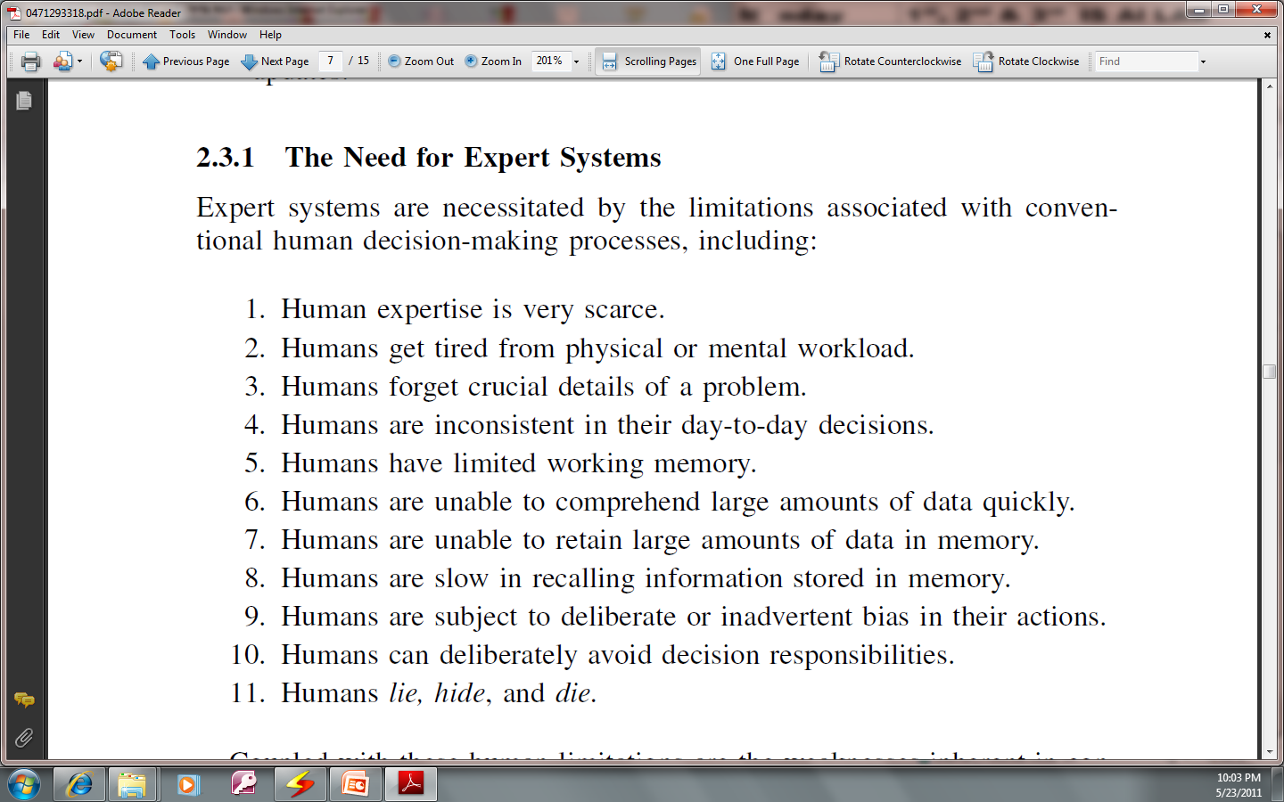
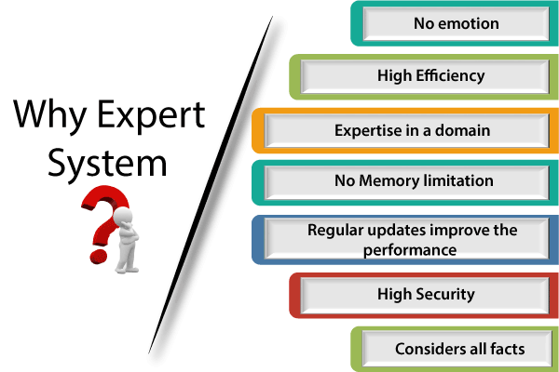
Why we need Expert Systems?

Slide 92
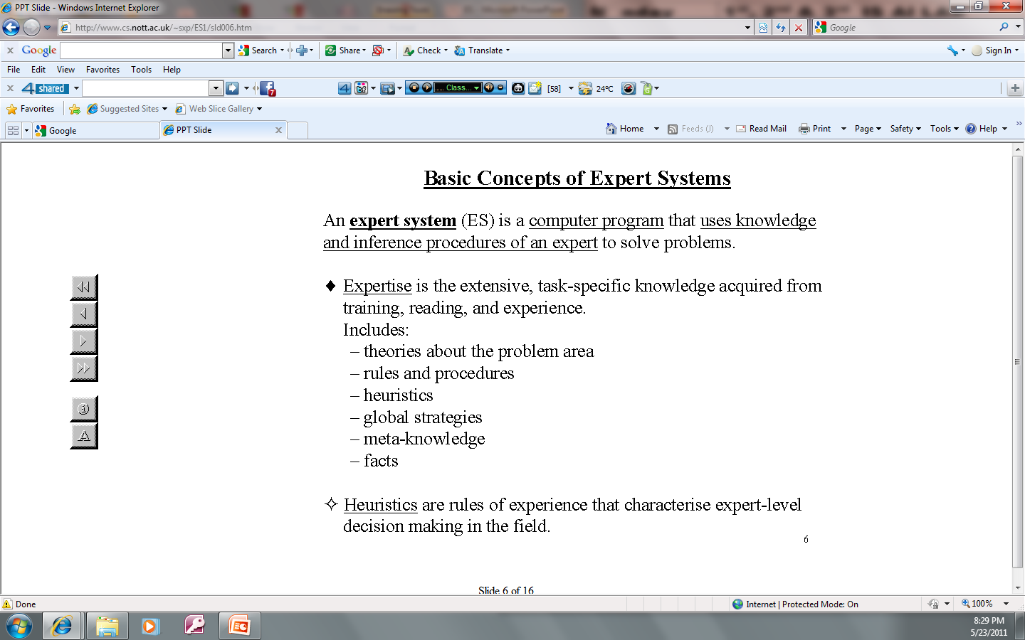
Basic concepts
Some concepts about Expert System (1)
It refers to knowledge about knowledge itself, or knowledge about how we acquire, represent, and reason with knowledge.

Slide 93
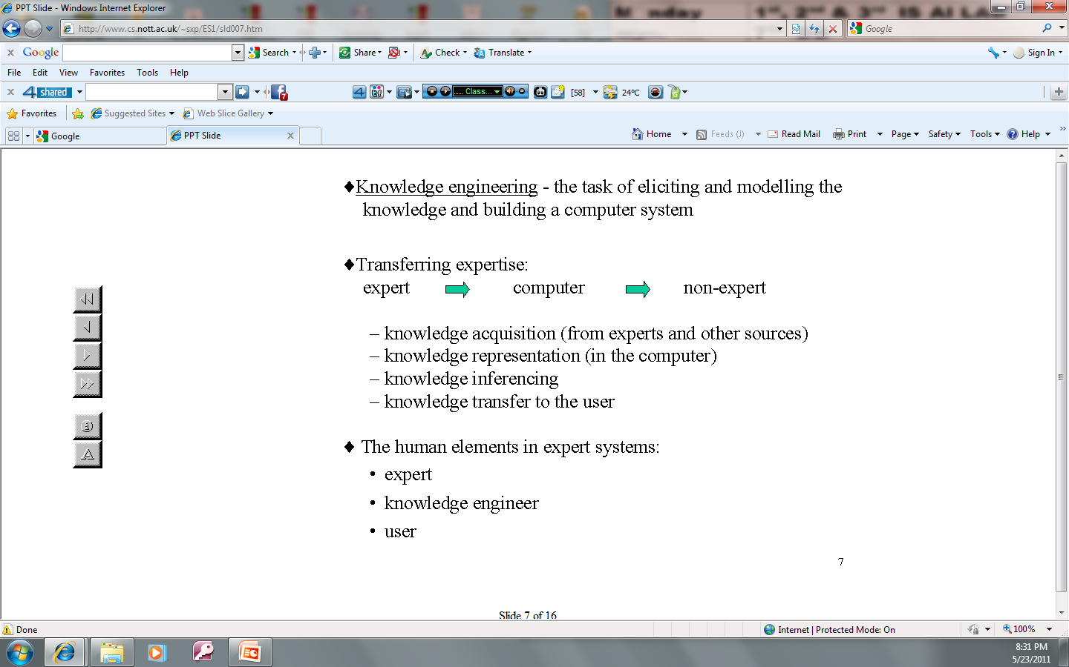

Conti..
Some concepts about Expert System (2)

Slide 94
Conti..
Some concepts about Expert System (3)
Knowledge Engineers – the people who build the system.
Knowledge Representation – the symbols used to represent the knowledge.
Factual Knowledge – knowledge of a particular task domain that is widely shared.
Heuristic Knowledge – more judgmental knowledge of performance in a task domain.

Slide 95
Characteristics of Expert system
Domain specificity: They operates in a micro-world where particular kind of problem solving is required.
Special Programming Languages: declarative languages such as Python, LISP and Prolog which are characterized by:
Efficient mix of integer and real variables.
Good memory-management procedures.
Extensive data-manipulation routines.
Incremental compilation.
Tagged memory architecture.
Optimization of the systems environment.
Efficient search procedures

Slide 96
Conti..
ES reasons over representation of human knowledge.
ES solves problems of genuine scientific or commercial interest through application of heuristic or approximate methods.
ES, unlike ‘algorithmic’ methods, are not guaranteed to succeed.
ES presents solutions in a reasonable time.
ES provide correct solutions most of the time-equal to or better than accuracy rate expected from a human expert.
Es follow difficult programs as good as or better than human experts.
ES posses vast quantities of domain specific knowledge to the minute details.
ES communicates with users in its own natural language.
ES provides extensive facilities for symbolic process rather than numeric process.

Slide 97
Advantages of Expert Systems
Increase the availability of the expert.
Increase the probability, frequency, and consistency of making good decisions.
Reduce cost and improve decision making: facilitate real-time, low-cost expert-level decisions by the non-expert.
Enhance the utilization of most of the available data.
Permit objectivity by weighing evidence without bias and without regard for the user’s personal and emotional reactions.
Permit dynamism through modularity of structure.
Reduce danger.
Provides better performance.
Multiple expertise: help distribute human expertise.

Slide 98
Conti..
Increase reliability.
Free up the mind and time of the human expert to enable him or her to concentrate on more creative activities.
Provides good explanation to the user.
Fast response.
Steady, unemotional, and complete responses at all times.
Intelligent tutor.
Intelligent database.
Encourage investigations into the subtle areas of a problem.

Slide 99
Expert Systems Vs. Conventional Programs

Slide 100
Conti..

Slide 101
Conti..

Slide 102
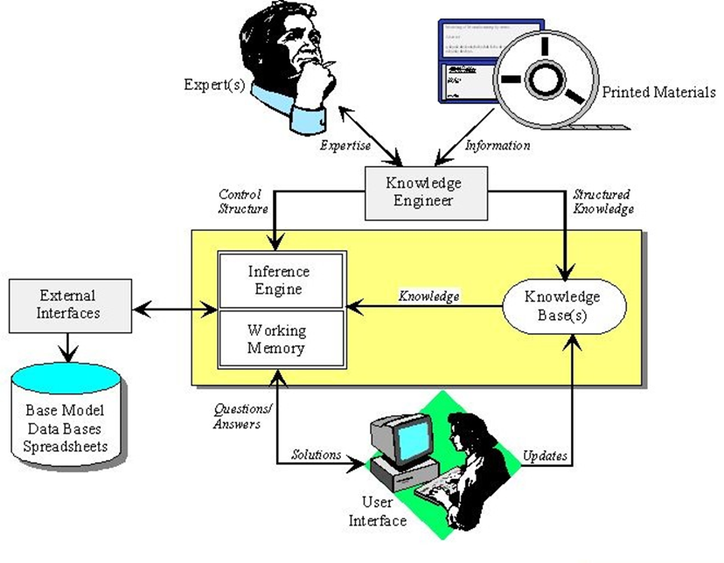
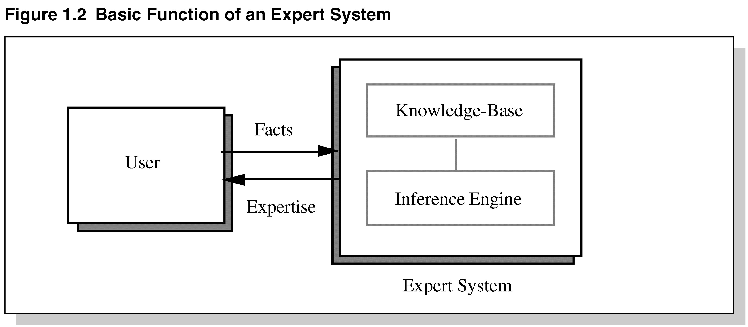
Basic components of Expert systems

Slide 103
Components of an Expert System
The knowledge base is the collection of facts and rules which describe all the knowledge about the problem domain.
The inference engine is the part of the system that chooses which facts and rules to apply when trying to solve the user’s query.
The user interface is the part of the system which takes in the user’s query in a readable form and passes it to the inference engine. It then displays the results to the user.

Slide 104
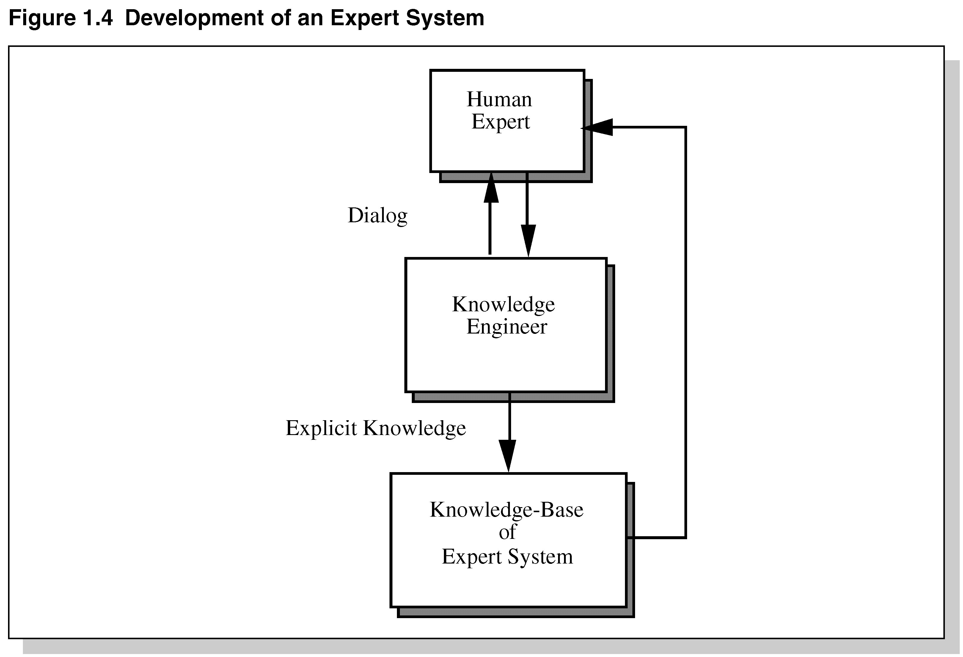
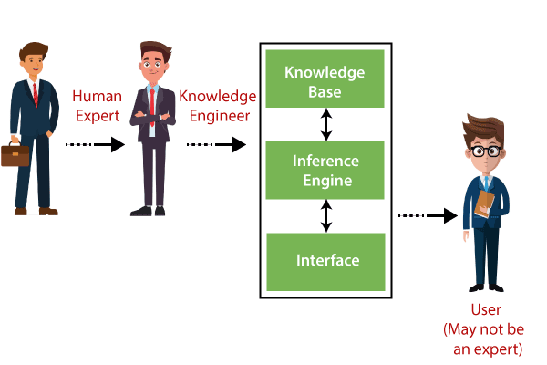
Development of an Expert System

Slide 105
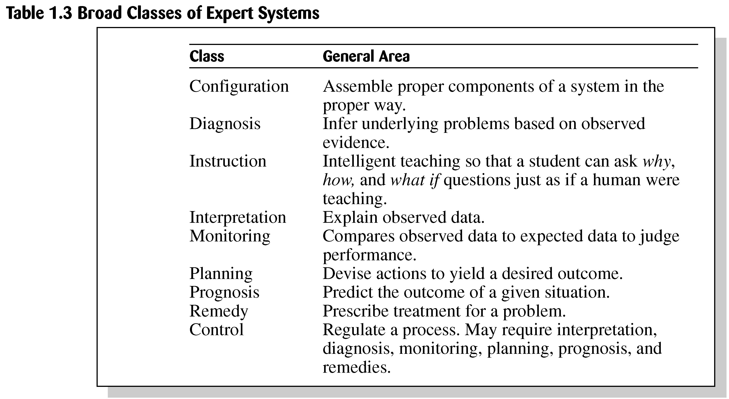
Expert System Applications
Area
Problems addressed

Slide 106
Conti..
Expert systems have a wide range of applications in AI, including:
Medical diagnosis: Expert systems can be used to diagnose medical conditions based on symptoms and other patient data. They can also be used to recommend treatments and medications based on the diagnosis.
Financial analysis: Expert systems can be used to analyze financial data and make investment recommendations based on market trends and other factors.
Manufacturing: Expert systems can be used to optimize manufacturing processes and improve quality control by identifying potential problems and recommending solutions.
Customer service: Expert systems can be used to provide personalized customer service by analyzing customer data and recommending products or services based on their needs and preferences.
Education: Expert systems can be used to provide personalized learning experiences by analyzing student data and recommending educational resources and activities based on their learning style and performance.

Slide 107

Limitations of Expert system
Not widely used or tested.
Limited to relatively narrow problems.
Cannot readily deal with “mixed” knowledge.
Possibility of error.
Cannot refine own knowledge base.
Difficult to maintain.
May have high development costs.
Raise legal and ethical concerns.

Slide 108
Legal and Ethical Issues
Who is responsible if the advice is wrong?
The user?
The domain expert?
The knowledge engineer?
The programmer of the expert system shell?
The company selling the software?

Slide 109
Conti..
Who provides the domain expertise in the form of problem-solving strategies?
Domain expert
Knowledge engineer
IT specialist
None of the above
Who formulates the domain expertise into an expert system?
Domain expert
Knowledge engineer
Domain specialist
None of the above

Slide 110


Slide 111


